Slide 1
Analysis on Image Fusion with Segmentation on Medical Images
GUIDE :
Mr. Dilli Babu
Assistant Professor
Panimalar Engineering College
G.Sivaranjani(211411205099)
R.Snegha(211411205100)
Srinitha Soundar(211411205101)
R.Subitsha(211411205104)

Slide 2
ABSTRACT
Brain tumor images exhibit complex characteristics, such as high variations in tumor appearance and ambiguous tumor boundaries. To address this problem, we propose novel automatic tumor segmentation along with fusion for brain tumor images.
Medical imaging field demands images with high resolution and higher information contents for necessary disease diagnosis and visualization.
Fusion of two or more images produces a new one which contains more accurate information on the scene than any of the individual source images.

Slide 3
EXISTING SYSTEM
Image is obtained by MRI/CT scans.
Obtained CT/MRI scanned image is subjected to segmentation.
Fuzzy-C means(FCM) algorithm is used for image segmentation.
Image is segmented into layers(L1,L2,L3..etc) and each layer is analysed to identify the tumours.
The identified tumour layer is extracted separately.
DRAWBACKS :
CT/MRI images are segmented separately, to view the tumours in hard and soft tissues respectively.
Manual understanding of area of tumour.
Can not determine all the area of tumours in a single image.

Slide 4
SURVEY 1
Title : A Nonparametric Method for Automatic Correction of Intensity Non-uniformity in MRI Data.
Authors: John G. Sled,* Alex P. Zijdenbos, Member, IEEE, and Alan C. Evans.
Advantages:
High performance is obtained without requiring a model of the tissue classes present.
The method can be applied at an early stage in an automated data analysis, before a tissue model is available.
Disadvantages:
It is not fully automatic.Needs experts advice and guidance.
Used to correct only the noisy images that are more complex in nature.

Slide 5
SURVEY 2
Title : Sparse Brain Network Recovery under Compressed Sensing.
Authors : Hyekyoung Lee, Dong Soo Lee, Hyejin Kang, Boong-Nyun Kim, and Moo K. Chung.
Advantages:
Used even to correct a small set of noisy measurement.
It is very much useful in predicting autism spectrum disorder children(ASD).
Disadvantages:
More complex.
Needs experts guidance and not fully automatic.

Slide 6
SURVEY 3
Title: Atlas based segmentation of pathological brain MR images.
Authors:M. Bach Cuadra, C. Pollo*, A. Bardera, O. Cuisenaire, J.-G. Villemure* and J.-Ph. Thiran
Advantages:
Mainly used to automate the process of identifying the tumor area in the brain.
Has its application in neurosurgery.
Disadvantages:
This model is insensitive to tumor growth.

Slide 7
SURVEY 4
Title: Segmentation of Brain tumor images based on Atlas registration combined with a Markov-Random Field Lesion growth model.
Authors:Stefan Bauer, Lutz-P. Nolte, Mauricio Reyes
Advantages:
The method is based on non-rigid registration of an average atlas in combination with a biomechanically justified tumor growth model to simulate soft-tissue deformations caused by the tumor mass-effect.
Disadvantages:
This method cannot be applied to compare the images of different scan types.

Slide 8
PROPOSED SYSTEM
Fusion incorporated with segmentation.
Firstly, CT and MRI scanned images are fusioned.
Secondly, fused image is subjected to segmentation to identify the exact area of tumors.
Tumors in hard and soft tissues are obtained in a single image.
This technique is used in synthetic images , medical images and natural images.

Slide 9
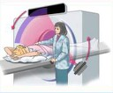
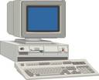
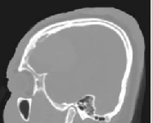
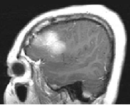

ARCHITECTURE DIAGRAM
Processing of the scanned images
Scanning
CT Scan
MRI Scan
Fusion of scanned images
Processing of the fused image for tumor detection using clustering algorithm
Tumor extracted image

Slide 10
SYSTEM REQUIREMENTS
Hardware requirements
Main Processor : Pentium IV
Hard Disk : 40 GB
RAM : 256 MB
Software requirements
Operating system : Windows Xp
Coding language : MATLAB

Slide 11
MODULES
Pre-processing
Image Fusion
Segmentation
Tumor Extraction

Slide 12
ALGORITHM
Step 1: Re-shaping
Step 2: Define the number of clusters
Step3 : Initialize the clusters to zero
Step4 : Centroid Calculation
        Centroid=max(pixel)-min(pixel)/ no. of clusters
Step 5: Distance matrix calculation

Slide 13
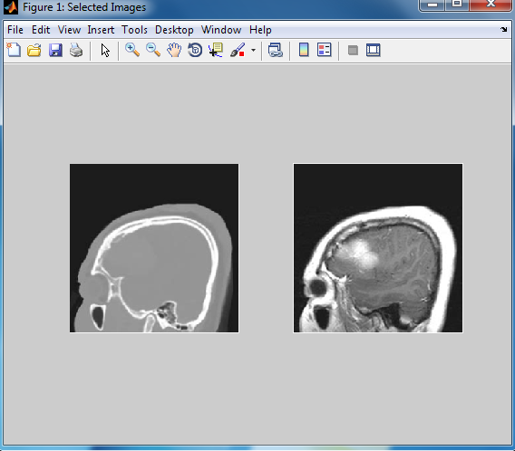
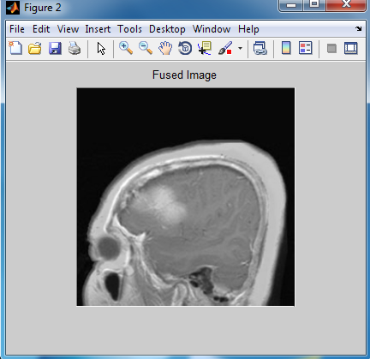
SNAPSHOTS
PRE-PROCESSING
IMAGE FUSION

Slide 14
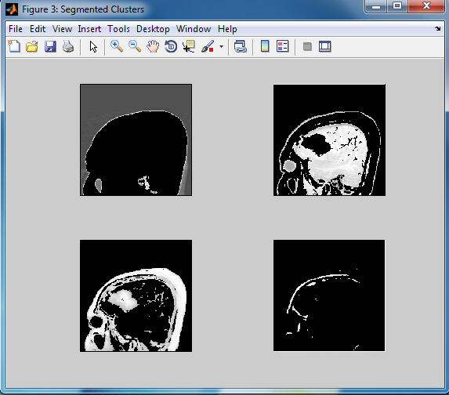
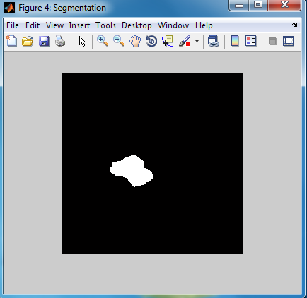
SNAPSHOTS
SEGMENTATION
TUMOR EXTRACTION

Slide 15
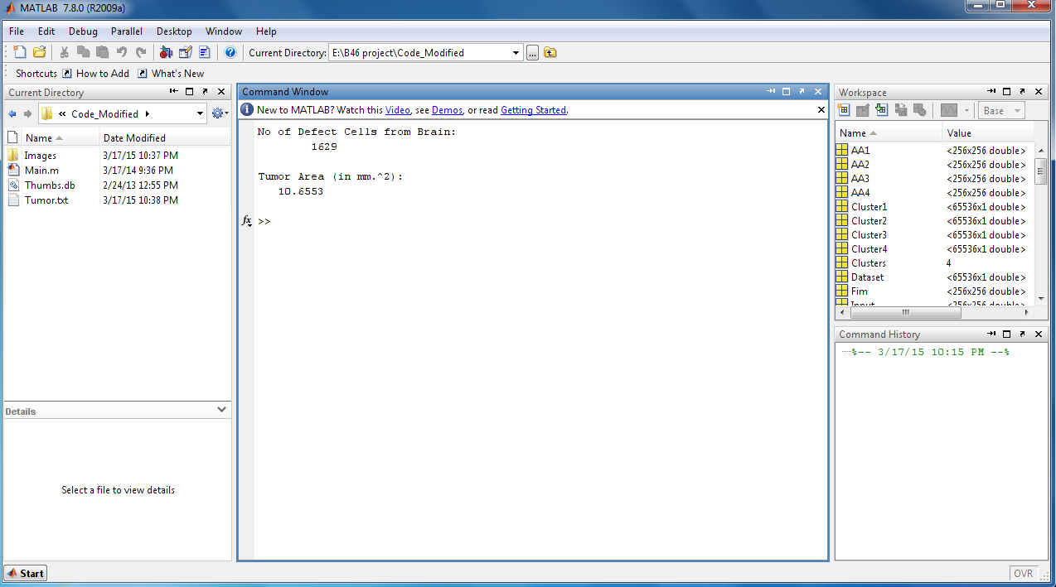
OUTPUT

Slide 16
CONCLUSION
This algorithm is completely automated which does not need any user interaction, not even to identify a start point.
After obtaining the centroid result through our algorithm which will provide better clustering.

Slide 17
FUTURE ENHANCEMENT
Our current research will focus the development of methods which provides the segmentation of coronary arteries in a sequence of angiographic images, while preserving the topology of the vessel structure

Slide 18
REFERENCES
[1] Meiyan Huang, Wei Yang, Yao wu, Jun Jiang, Wufan Chen, Senior Member, IEEE, and Qianjin Feng*, Member, IEEE “Brain tumor Segmentation Based on Local Independent Projection-based Classification,” IEEE Transactions on Biomedical Engineering Sep2014.
[2]J.G.Sled, A.P.Zijdenbos, and A.C.Evans,” A Non-parametric method for automatic correction of intensity non-uniformity in MRI data,” IEEE Transactions on Medical Imaging, vol. 17, no. 1, pp. 87-97, Feb1998
[3]H. Loe, D.S. Lee, H. Kang,B.N. Kim,and M.K.Chung,” Sparse brain network recovery under compressed sensing,” IEEE Transactions on Medical Imaging, vol.30, no.5,pp. 1154-1165, May 2011.

Slide 19
REFERENCES
[4]M.B.Cuadra, C.Pollo, A.Bardera, O.Cuisenaire, J.G.Villemure, and J.P.Thiran, “Atlas-based segmentation of pathological MR brain images using a lesion growth,” IEEE Transactions on Medical Imaging, vol. 23, no. 10,pp. 1301-1314, 2004.
[5] Dina Aboul Dahab, Samy S. A. Ghoniemy, Gamal M. Selim,”Automated Brain Tumor Detection and Identification Using Image Processing and Probabilistic Neural Network Techniques,”vol. 1, Oct2012
[6] J.Wright, A.Y.Yang, A.Ganesh, S.S.Sastry, and Y.Ma, “Robust face recognition via sparse representation,” IEEE Trans Pattern anal mach intell ,vol. 31, no. 2, pp. 210-227, Feb 2009

